Slide 1
Transparent Machine Learning
Noor Akhmad Setiawan
Department of EE and IT
Universitas Gadjah Mada

Slide 2
Machine Learning
One of Machine Learning definition:
“A computer program is said to learn from experience E with respect to some class of tasks T and performance measure P if its performance at tasks in T, as measured by P, improves with experience E”
(Tom M Mitchell - CMU)

Slide 3
Types of Learning
Supervised -> labeled data & more on prediction
Unsupervised -> unlabeled data & more on pattern finding
Semi-Supervised -> combined

Slide 4
Outputs
Clustering (Unsupervised)
Two-class and multi-class classification (Supervised)
Association (Supervised)
Regression: Univariate, Multivariate, etc. (Supervised)
Anomaly detection (Unsupervised and Supervised)
Recommendation systems (Recommendation Engine)

Slide 5
Algorithms
Supervised Regression
Simple and multiple linear regression
Decision tree or forest regression
Artificial Neural networks
Nearest neighbor methods (e.g., k-Nearest Neighbors), etc.

Slide 6
Algorithms
Supervised Two-class & Multi-class Classification
Logistic regression and multinomial regression
Artificial Neural networks
Decision tree, forest, and jungles
SVM (support vector machine)
Bayesian classifiers (e.g., Naive Bayes)
Nearest neighbor methods (e.g., k-Nearest Neighbors)
One versus all multiclass, etc.

Slide 7
Algorithms
Unsupervised
K-means clustering
Hierarchical clustering
Association
Apriori
FP Growth
Anomaly Detection
Support vector machine (one class)
Ensemble Method
Random forest

Slide 8
Issues in Machine Learning
Transparency -> “solved” by Decision Tree
Accuracy -> “solved” by Deep Learning
However,
“Transparent and Accurate?” -> ???

Slide 9
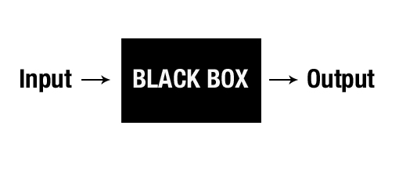
Transparency
As Machine Learning algorithms get smarter, they are also becoming more incomprehensible.

Slide 10
Transparency and Trust
“If we don't worry about the explanation, we won't be able to trust the systems.“
(Manuela Veloso – CMU)
"For a machine learning (ML) system to be useful in solving medical diagnosis tasks, the following features are desired: good performance, the ability to appropriately deal with missing data and with noisy data (errors in data), the transparency of diagnostic knowledge, the ability to explain decisions, and the ability of the algorithm to reduce the number of test necessary to obtain reliable diagnosis."
(Igor Kononenko - University of Ljubljana)

Slide 11
Types of ML Applications
Type A applications -- in which model predictions are used to support consequential decisions that can have a profound effect on people’s lives such as medical diagnosis, loan applications, self-driving cars, and policing and prison sentencing; and -> need transparency.
Type B applications -- in which model predictions are used in settings of lower consequence and large scale, such as which streaming video to watch, the news that gets shown at the top of a news-feed, and search queries. -> transparency is not too important.

Slide 12
Comparison of ML Algorithms

Slide 13
Improving Performance
Increase the accuracy of transparent ML algorithms -> ensemble, deep learning for DT?
Increase the transparency of accurate ML algorithms -> black box to clear box.
OR
Hybrid approaches -> e.g., Deep Rough Neural Network.

Slide 14
Example of Transparent ML
C4.5 or C5.0 (available in rulequest, Scikit Learn)
RIPPER (Jrip in WEKA)
Rough Set Theory (ROSETTA, RSES, ROSE, R-Package ‘RoughSets’)

Slide 15
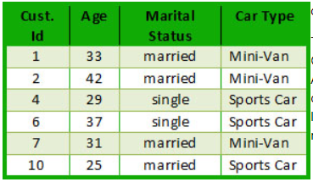
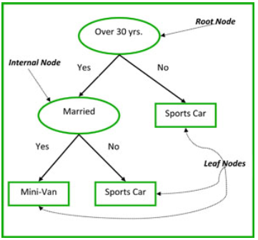
C4.5

Slide 16
C4.5
Extending ID3:
to permit numeric attributes: straightforward
to deal sensibly with missing values: trickier
stability for noisy data: requires pruning mechanism
End result: C4.5 (Quinlan)
Best-known and (probably) most widely-used learning algorithm
Commercial successor: C5.0

Slide 17
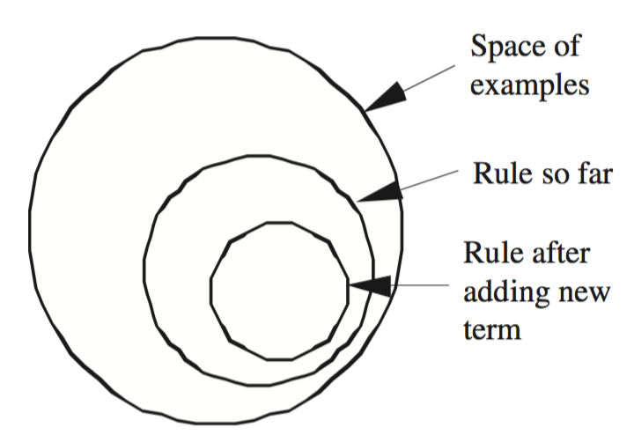
Covering Algorithm
Basic idea: generate a rule by adding tests that maximize the rule’s accuracy
Similar to situation in decision trees: problem of selecting an attribute to split on
    But: decision tree inducer maximizes overall purity
Each new test reduces
rule’s coverage:

Slide 18
Selecting a test
Goal: maximize accuracy
    t total number of instances covered by rule
    p positive examples of the class covered by rule
    t – p number of errors made by rule
    Select test that maximizes the ratio p/t
We are finished when p/t = 1 or the set of instances cannot be split any further

Slide 20
Rule we seek:
If ?
then recommendation = hard
Final rules (first pass):
If astigmatism = yes
and tear production rate = normal
and spectacle prescription = myope
then recommendation = hard

Slide 21
RIPPER
RIPPER: Repeated Incremental Pruning to Produce Error Reduction
Performs global optimization in an efficient way
Classes are processed in order of increasing size
Initial rule set for each class is generated using IREP (Incremental reduced-error pruning)
An MDL-based stopping condition is used
DL: bits needs to send examples wrt set of rules,
bits needed to send k tests, and bits for k
Once a rule set has been produced for each class, each rule is re-considered and two variants are produced
One is an extended version, one is grown from scratch
Chooses among three candidates according to DL
Final cleanup step greedily deletes rules to minimize DL

Slide 22
Rough Set Theory (RST)
Rough set theory was developed by Zdzislaw Pawlak in the early 1980’s.
Representative Publications:
  Z. Pawlak, “Rough Sets”, International Journal of Computer and Information Sciences, Vol.11, 341-356 (1982).
  Z. Pawlak, Rough Sets - Theoretical Aspect of Reasoning about Data, Kluwer Academic Publishers (1991).

Slide 23
Applications
It can be used for feature selection, feature extraction, data reduction, decision rule generation, and pattern extraction (templates, association rules) etc.
Identifies partial or total dependencies in data, eliminates redundant data, gives approach to null values, missing data, dynamic data and others.

Slide 24
Decision Table

Slide 25
Indiscernibility

Slide 26
Set Approximation

Slide 27
Set Approximation (2)

Slide 28
Reducts
Keep only those attributes that preserve the indiscernibility relation and, consequently, set approximation.
There are usually several such subsets of attributes and those which are minimal are called reducts.

Slide 29
Discernibility Matrix

Slide 30
Rule Induction

Slide 31
Rule Induction (2)

Slide 32
Deep Rough Sets + Rough NN

Slide 33
Summary
Transparency is still an open problem in Machine Learning research.
Developing high performance transparent Machine Learning algorithms is the future direction of Machine Learning research.
Available transparent Machine Learning algorithms can be used to develop AI applications that needs trust and ability to explain its decisions.
Basic idea of decision tree, rule generation, and RST has been explored.

Slide 34
Thank you

